Slide 1
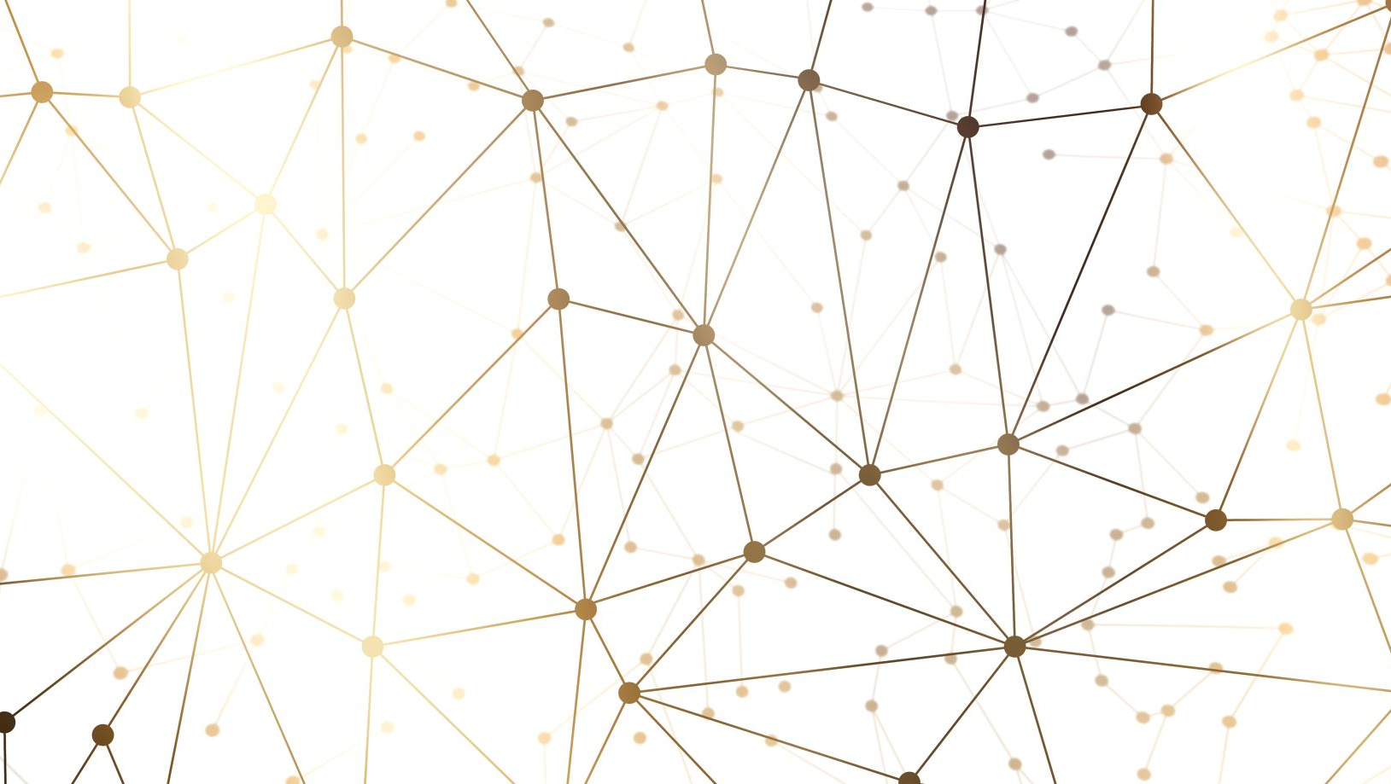
Robust Learning of Simplices
Blaine Mason

Slide 2
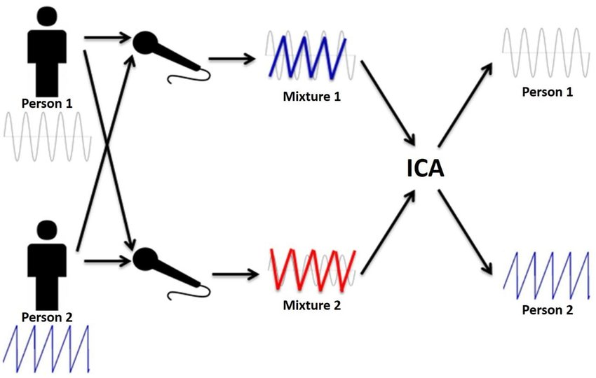
The Cocktail Party Problem

Slide 3
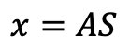
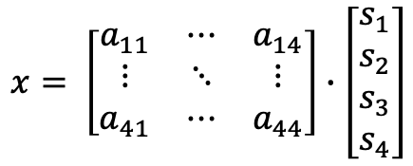
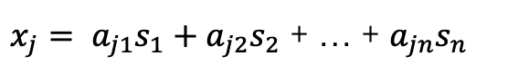
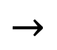
Definition of ICA
$$x=AS$$
$$x= \left[\begin{matrix}a_{11} & ⋯ & a_{14} \\ ⋮ & ⋱ & ⋮ \\ a_{41} & ⋯ & a_{44}\end{matrix}\right]∙\left[\begin{aligned}s_{1} \\ s_{2} \\ s_{3} \\ s_{4}\end{aligned}\right]$$
$$→$$
$x_{j}= a_{j1}s_{1}+a_{j2}s_{2}$ + … + $a_{jn}s_{n}$

Slide 4
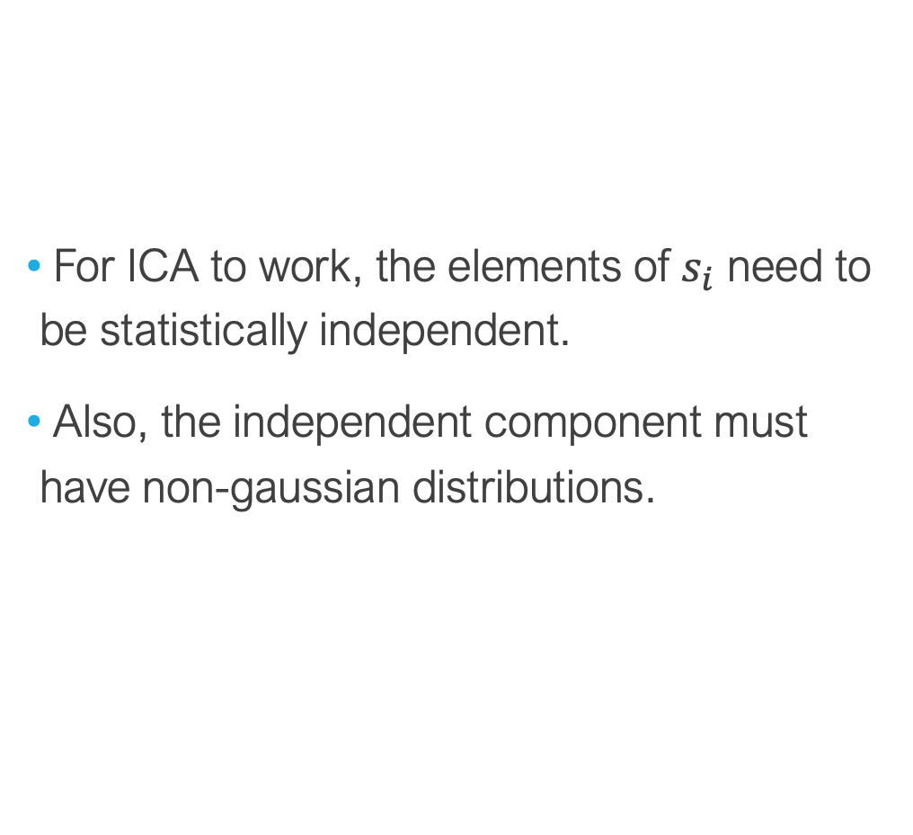
Assumptions of ICA
For ICA to work, the elements of $s_{i}$ need to be statistically independent.
Also, the independent component must have non-gaussian distributions.

Slide 5

Ambiguities of ICA
1.) We cannot determine the variances of the independent components
This ambiguity is insignificant in most applications, due to the ability to scale the independent components by -1 and still have the model remain unchanged.
2.) We cannot determine the order of the independent components.
Since S and A are unknown or latent, the order of the components do not matter. So, in the ICA model, any of the terms could be interchanged and still obtain the combined signal.
$x_{j}= a_{j1}s_{1}+a_{j4}s_{4}$+ $a_{j3}s_{3}$+ $a_{j2}s_{2}$+ … + $a_{jn}s_{n}$
Components 4 and 2 are switched, but the same combined signal will exist in the end

Slide 6
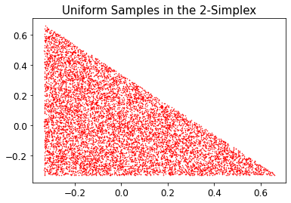
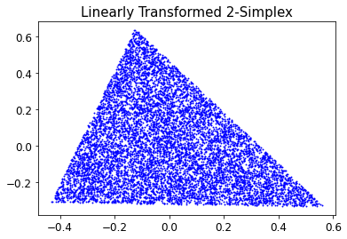
Simplex
$$2−simplex= \{(x_{i},y_{i})∈ℝ^{2}:x_{i}+y_{i}≤1 and{ x}_{i},y_{i}≥0 ∀i=0,…,N\}$$

Slide 7
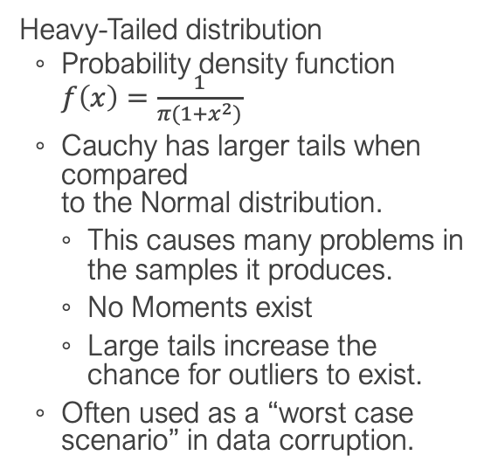
Statistical Noise
Heavy-Tailed distribution
Probability density function $f\left(x\right)=\frac{1}{π(1+x^{2})}$
Cauchy has larger tails when compared to the Normal distribution.
This causes many problems in the samples it produces.
No Moments exist
Large tails increase the chance for outliers to exist.
Often used as a “worst case scenario” in data corruption.

Slide 8
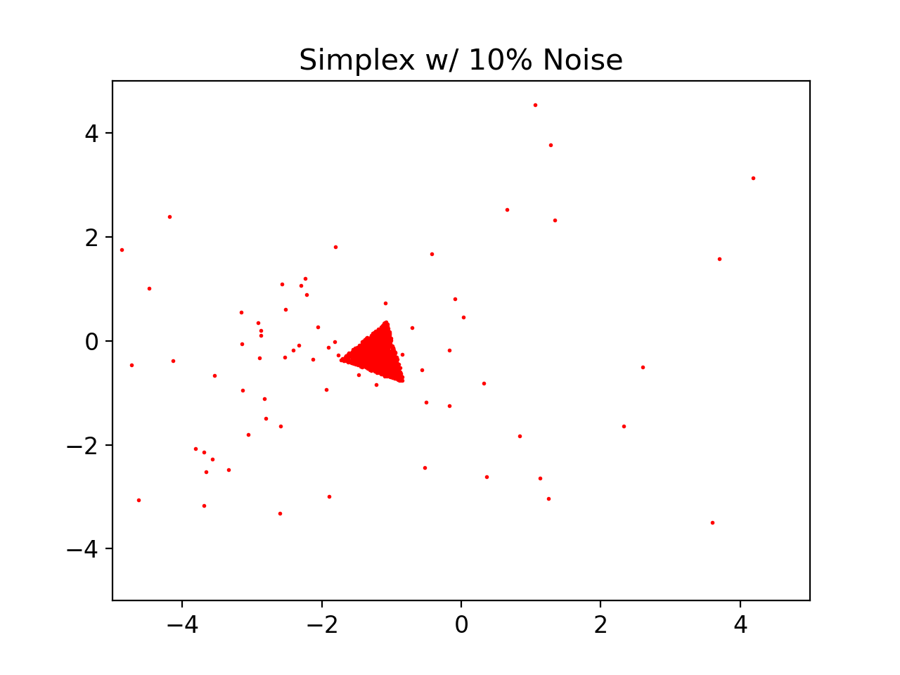
NOISE MODEL

Slide 9
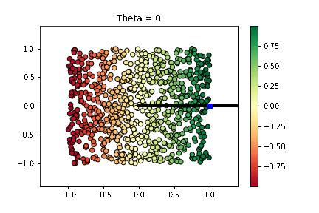
Floating Body

Slide 10
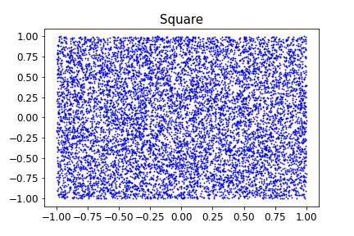
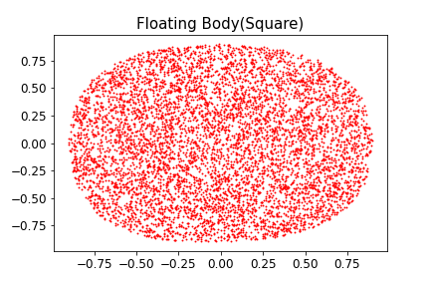
Floating Body of the Unit Square

Slide 11
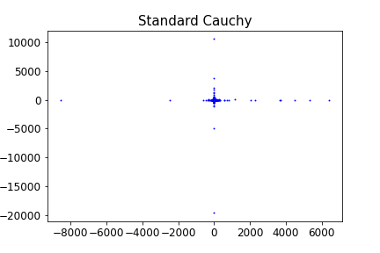
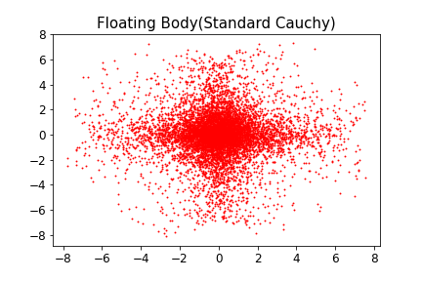
Floating Body of Cauchy Samples

Slide 12
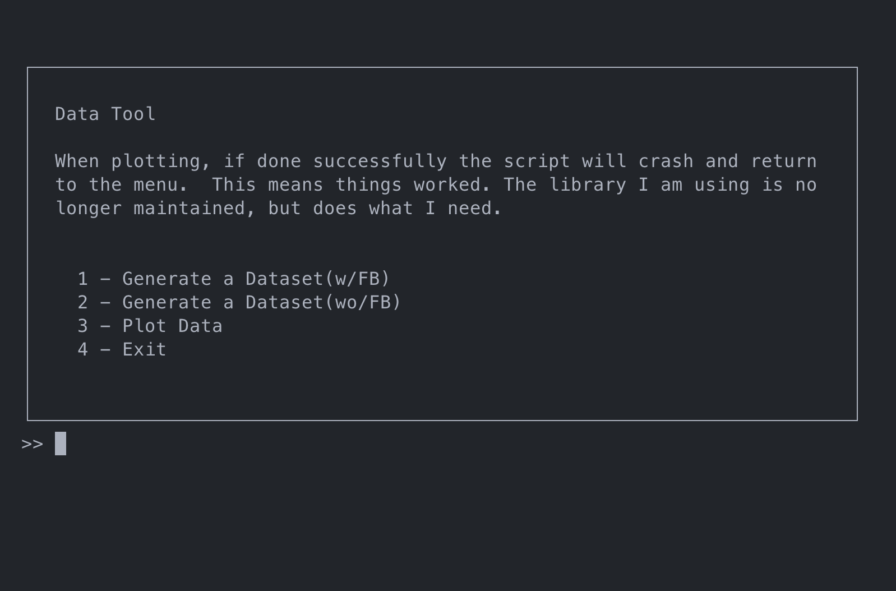
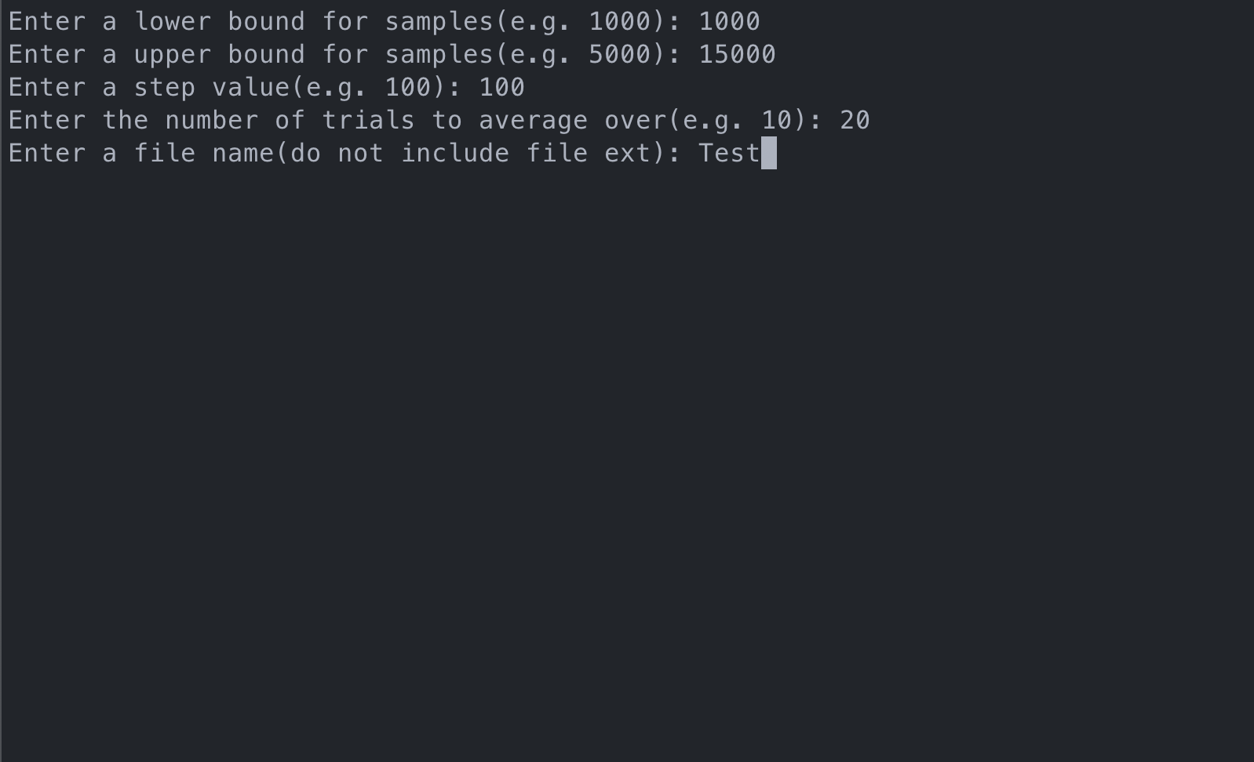
Data Collection

Slide 13
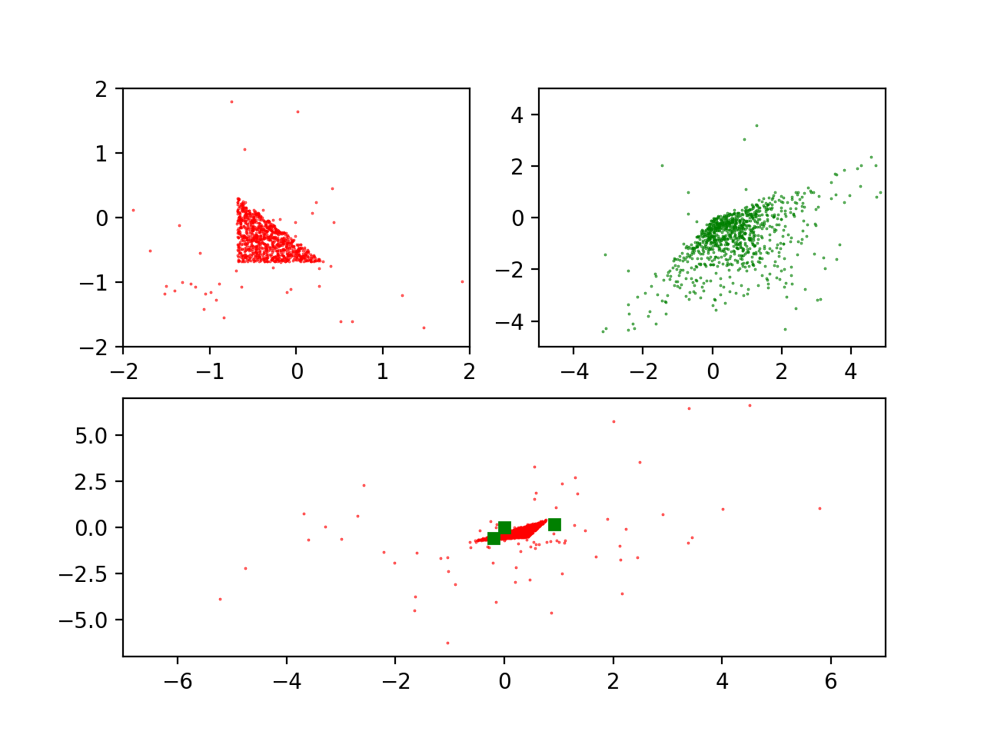
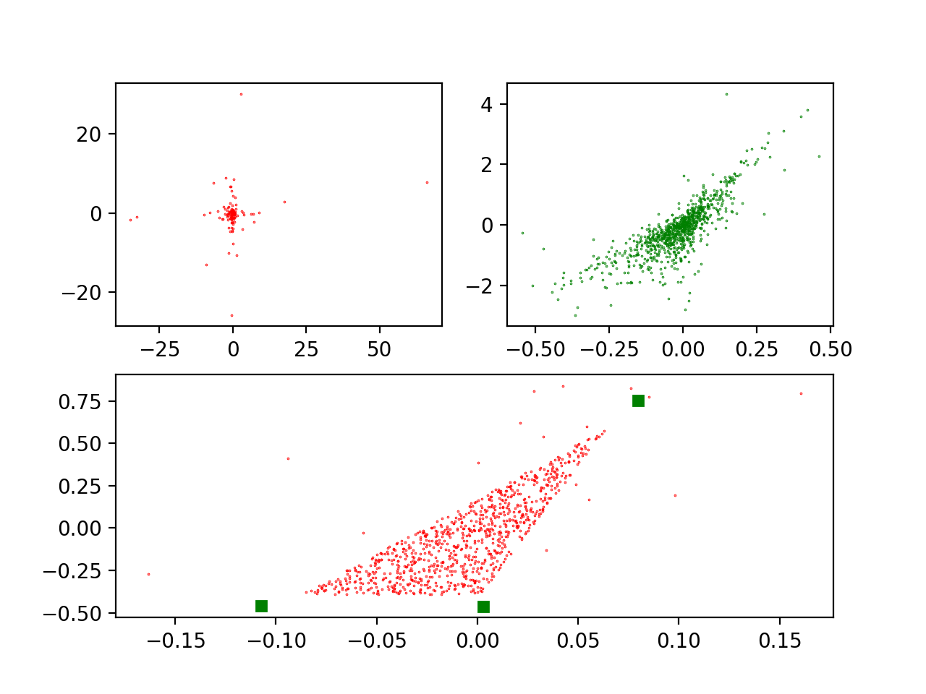
Learning Efficiently and Robustly
WITHOUT FLOATING BODY
WITH FLOATING BODY

Slide 14
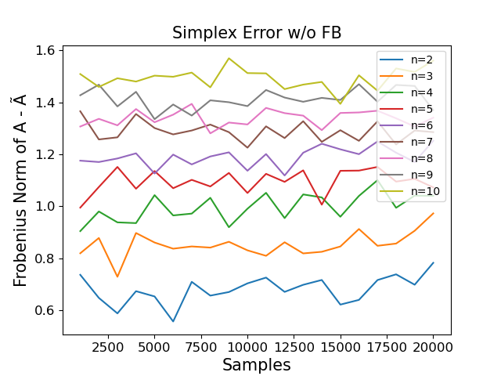
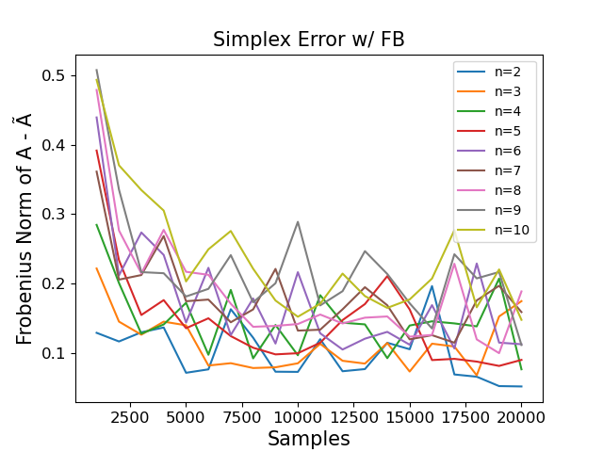
Results

Slide 15
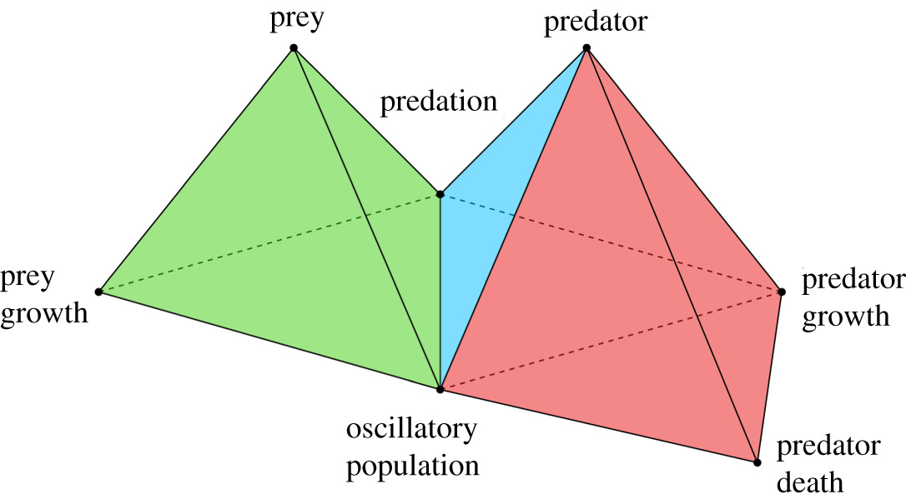
Applications

Slide 16
References
[1] Lubo-Robles, David. (2018). DEVELOPMENT OF INDEPENDENT COMPONENT ANALYSIS FOR RESERVOIR GEOMORPHOLOGY AND UNSUPERVISED SEISMIC FACIES CLASSIFICATION IN THE TARANAKI BASIN, NEW ZEALAND.. 10.13140/RG.2.2.32067.50724.
[2] Hyvärinen, Aapo, and Erkki Oja. "Independent component analysis: algorithms and applications." Neural networks 13.4-5 (2000): 411-430.
[3] Vittadello, S. T., & Stumpf, M. P. H. (2021, October 13). Model comparison via simplicial complexes and persistent homology. Royal Society Open Science. Retrieved November 21, 2022, from https://royalsocietypublishing.org/doi/10.1098/rsos.211361

